Slide 1

Solutions to Human Factor ISSUES in ASMIS
Individual Presentation
Nitin Subramaniam

Slide 2
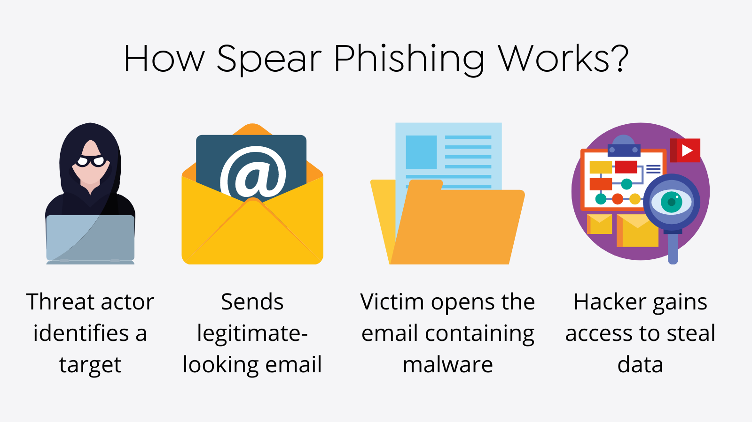
Phishing
Training on phishing detection and incident response.
Leadership approval
Development of scenarios
Selection and deployment of phishing tools
Report on metrics
(SOCRadar® Cyber Intelligence Inc., 2022)

Slide 3
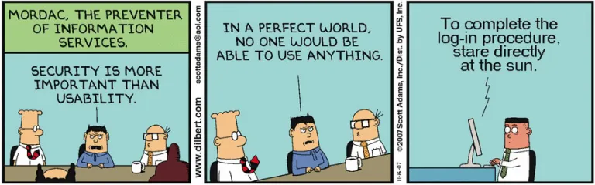
Usable Security
Design security early
Security should not compromise performance
Lessen cognitive stress
Simple design
Develop a precise mental model
Security
Functionality
Usability

Slide 4
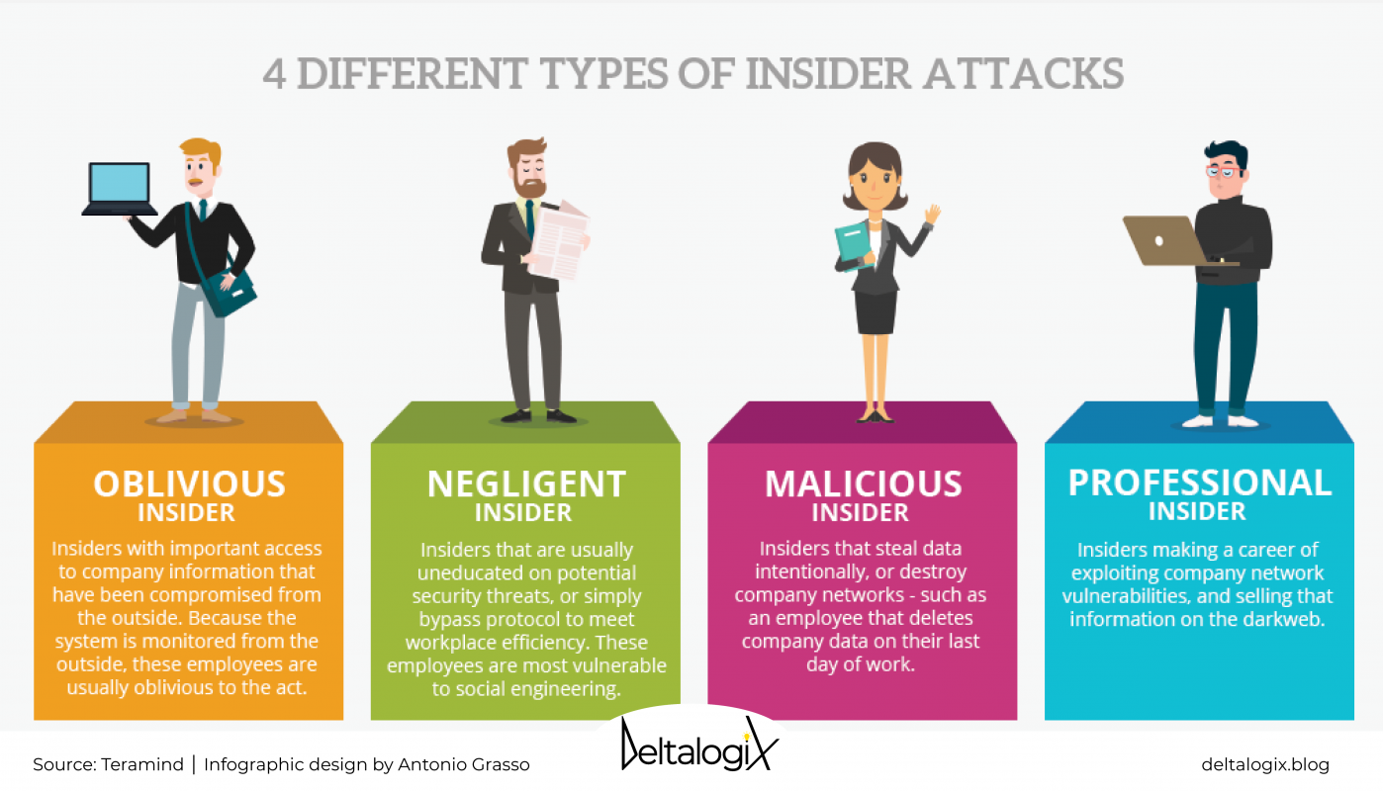
Insider threat
Detection of Insider Threat
Used System
Location
Time
Session Duration
(DeltalogiX, 2021)

Slide 5
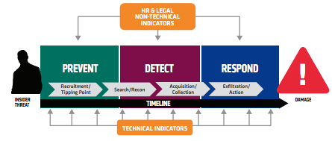
Insider threat
Deterrence and Prevention to mitigate insider threats
Sanction according to the severity
Increase effort
Increase risk
Remove excuses
Announce intention
(Cappelli, Moore and Trzeciak, 2012)

Slide 6
references
SOCRadar® Cyber Intelligence Inc. (2022). How to Identify Spear Phishing? [online] Available from: https://socradar.io/how-to-identify-spear-phishing/ [Accessed 19 Jul. 2022]
‌DeltalogiX. (2021). Insider threat: 4 potential threats to your business. [online] Available from: https://deltalogix.blog/en/2021/07/07/internal-attack-4-employee-identikits-that-could-prove-to-be-a-threat-to-your-company/ [Accessed 19 Jul. 2022]
Safa, N.S., Maple, C., Furnell, S., Azad, M.A., Perera, C., Dabbagh, M. and Sookhak, M. (2019). Deterrence and prevention-based model to mitigate information security insider threats in organisations. Future Generation Computer Systems, 97, pp.587–597. doi:10.1016/j.future.2019.03.024.
Cappelli, D.M., Moore, A.P. and Trzeciak, R.F. (2012). The CERT Guide to Insider Threats: How to Prevent, Detect, and Respond to Information Technology Crimes (Theft, Sabotage, Fraud). [online] Google Books. Addison-Wesley. Available at: https://books.google.ae/books?hl=en&lr=&id=VvBLK91q4LEC&oi=fnd&pg=PR7&dq=prevent+insider+threats&ots=x6rRNd55cC&sig=DLRZHLXFtlbnnHTaNeFKbaaY2oI&redir_esc=y#v=onepage&q&f=false [Accessed 20 Jul. 2022].
Bada, M., Sasse, A. and Nurse, J. (2019). Cyber Security Awareness Campaigns: Why do they fail to change behaviour? [online] Available from: https://arxiv.org/ftp/arxiv/papers/1901/1901.02672.pdf [Accessed 20 Jul. 2022].
Nurse, J.R.C., Creese, S., Goldsmith, M. and Lamberts, K. (2011). Guidelines for usable cybersecurity: Past and present. 2011 Third International Workshop on Cyberspace Safety and Security (CSS). [online] doi:10.1109/css.2011.6058566.
‌

Slide 7

Thank you

